Slide 1
An Active Learning Approach for Botnet Detection
Mehrdad Hajizadeh
TU-Chemnitz
<number>

Slide 2
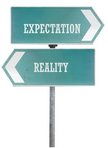

Problem Formulation
Unlabeled Data
Supervised Learning
Deep Learning
For many more sophisticated supervised learning tasks, labeled instances are very difficult, time-consuming, or expensive to obtain.
<number>

Slide 3
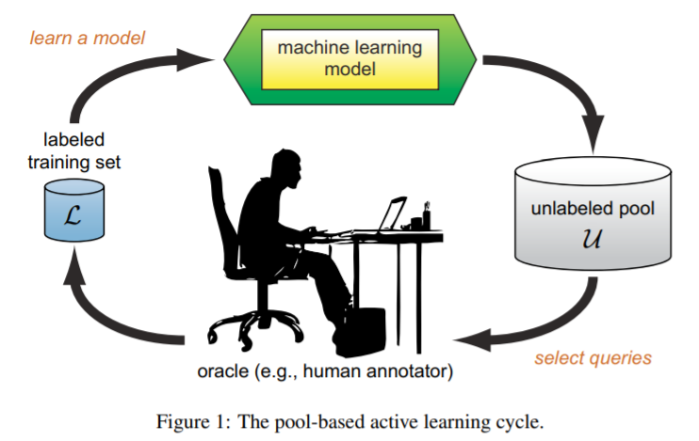
Active Learning
There are several scenarios in which active learners may pose queries, and there are also several different query strategies that have been used to decide which instances are most informative.
Fig 1: A learner may begin with a small number of instances in the labeled training set L, request labels for one or more carefully selected instances, learn from the query results, and then leverage its new knowledge to choose which instances to query next. Once a query has been made, there are usually no additional assumptions on the part of the learning algorithm. The new labeled instance is simply added to the labeled set L, and the learner proceeds from there in a standard supervised way.
http://burrsettles.com/pub/settles.activelearning.pdf
<number>

Slide 4
Typical Active Learning Scenarios
The classical scenario
  specifes the number of labels provided by oracle.
The cost-sensitive active learning scenario involves query cost and misclassifcation costs.
  The learning task is to achieve a trade-of between them to minimize the total cost.
The active learning from data streams scenario involves dynamic nature of the data.
  The learner should query instances based on the data observed so far to maximize the classifcation accuracy on future instances
<number>
http://www.fansmale.com/downloadRAR/publicationPdf/Min2020.pdf

Slide 5
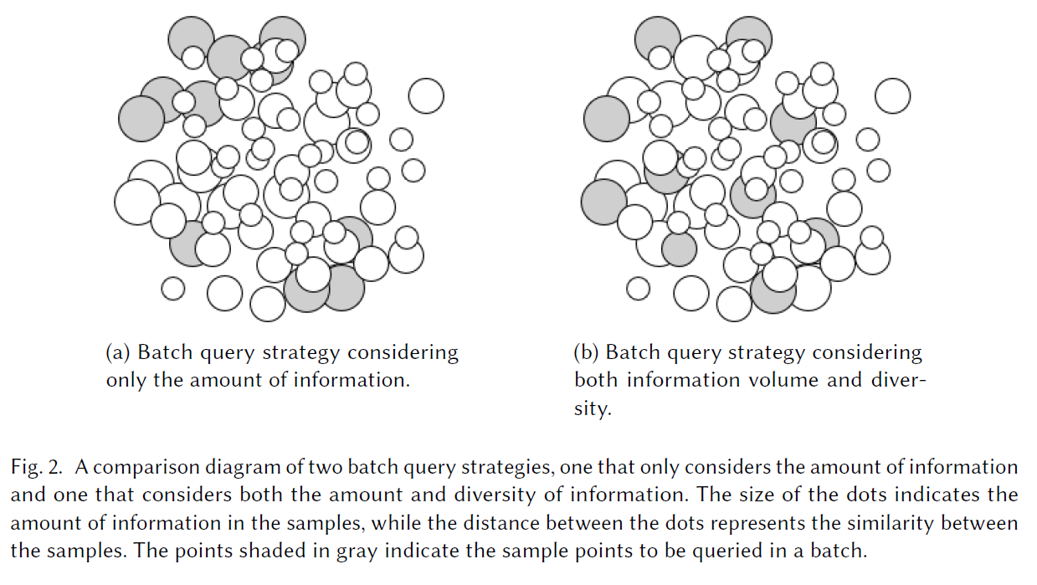
Batch Query Strategy
The information provided to the model by such similar samples is essentially the same, which not only wastes labeling resources, but also makes it difficult for the model to learn genuinely useful information. Therefore, it is important to query a set of samples that are both information-rich and diverse.
<number>
Paper:A Survey of Deep Active Learning

Slide 6
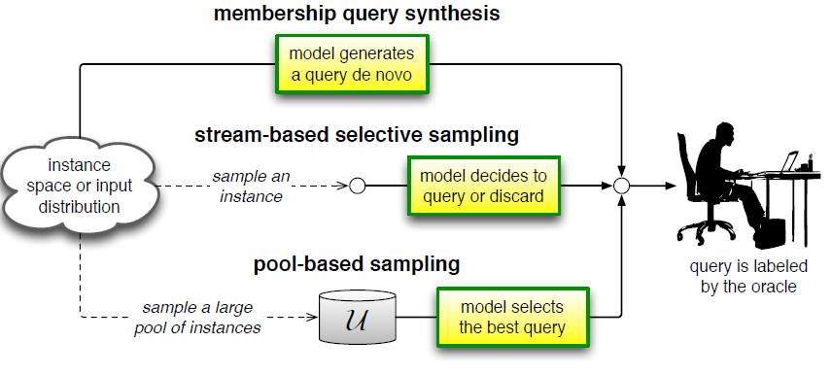
Active Learning Categories based on Query
Stream-based selective sampling
  In this scenario, the algorithm determines if it would be beneficial enough to query for the label of a specific unlabeled entry in the dataset. While the model is being trained, it is presented with a data instance and immediately decides if it wants to query the label. This approach has a natural disadvantage that comes from the lack of guarantee that the data scientist will stay within budget.
Pool-based sampling
  This is the most well known scenario for active learning. In this sampling method, the algorithm attempts to evaluate the entire dataset before it selects the best query or set of queries. The active learner algorithm is often initially trained on a fully labeled part of the data which is then used to determine which instances would be most beneficial to insert into the training set for the next active learning loop. The downside of this method is the amount of memory it can require.
Membership query synthesis
  This scenario is not applicable to all cases, because it involves the generation of synthetic data. The active learner in this method is allowed to create its own examples for labeling. This method is compatible with problems where it is easy to generate a data instance.
Diagram illustrating the three main active learning scenarios
http://burrsettles.com/pub/settles.activelearning.pdf
https://algorithmia.com/blog/active-learning-machine-learning
<number>
The pool-based active learning cycle
Ref: A Survey of Deep Active Learning

Slide 7
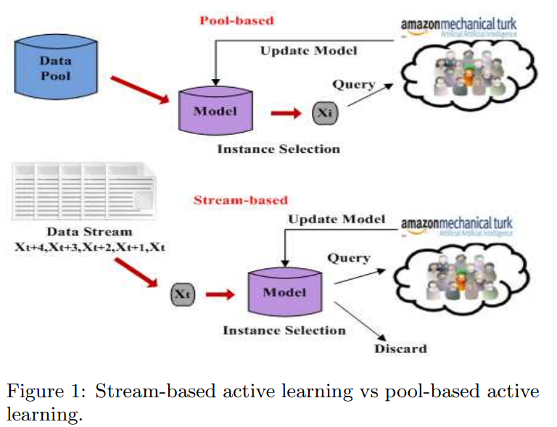
Pool Based vs Stream Based
The main difference between stream-based and pool-based active learning is that the former scans through the data sequentially and makes query decisions individually, whereas the latter evaluates and ranks the entire collection before selecting the best query.
While the pool-based scenario appears to be much more common among application papers, one can imagine settings where the stream based approach is more appropriate. For example, when memory or processing power may be limited, as with mobile and embedded devices.
<number>
Fig from Paper: Feedback-Driven Multiclass Active Learning for Data Streams

Slide 8
Query Strategy Frameworks
Uncertainty Sampling
  an active learner queries the instances about which it is least certain how to label. This approach is often straightforward for probabilistic learning models. For example, when using a probabilistic model for binary classification, uncertainty sampling simply queries the instance whose posterior probability of being positive is nearest 0.5
  Uncertainty sampling strategies may also be employed with non-probabilistic classifiers.
    decision tree classifier, nearest-neighbor, SVM (that involves querying the instance closest to the linear decision boundary)
Query-By-Committee
  The QBC approach involves maintaining a committee C = {clf1,clf2,…clf(n)} of models which are all trained on the current labeled set L, but represent competing hypotheses. Each committee member is then allowed to vote on the labelings of query candidates. The most informative query is considered to be the instance about which they most disagree.
Expected Model Change
  It uses a decision-theoretic approach, selecting the instance that would impart the greatest change to the current model if we knew its label.
  E.g, “expected gradient length” (EGL) where the learner should query the instance x which, if labeled and added to L, would result in the new training gradient of the largest magnitude.
  The intuition behind this framework is that it prefers instances that are likely to most influence the model (i.e., have greatest impact on its parameters), regardless of the resulting query label.
  Calculate gradient? Read page 18, 19. Also see TensorFlow document
Expected Error Reduction
Variance Reduction
Density-Weighted Methods
http://burrsettles.com/pub/settles.activelearning.pdf
<number>

Slide 9
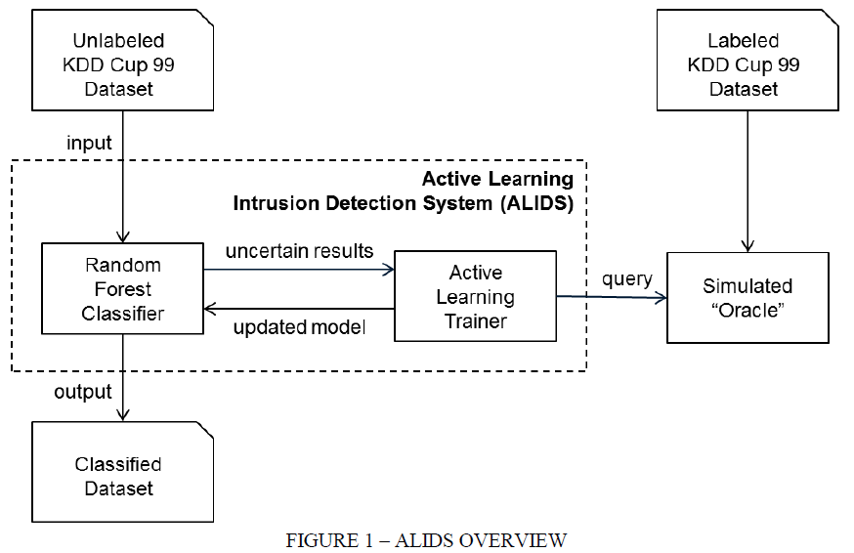
How to Find Diverse Samples?
Papar: Active Learning Intrusion Detection using k-Means Clustering Selection IEEE 2017
This papar provide a solution to select more diverse samples among those data poins which considered as low-confidence.
  The second function of the active learning trainer is to create a diverse sample from the low-confidence dataset. ALIDS uses k-means clustering to select a diverse sample.
  The number of clusters used was equal to the number of samples selected for sending to the oracle. Thus each sample was taken from a cluster that represented records more like each other and less like the records in other clusters. This guaranteed a more diverse sample to present to the oracle than could be provided through random sampling.
  The use of k-means clustering allows for the preselection of the number of clusters and is computationally efficient for large datasets.
<number>

Slide 10
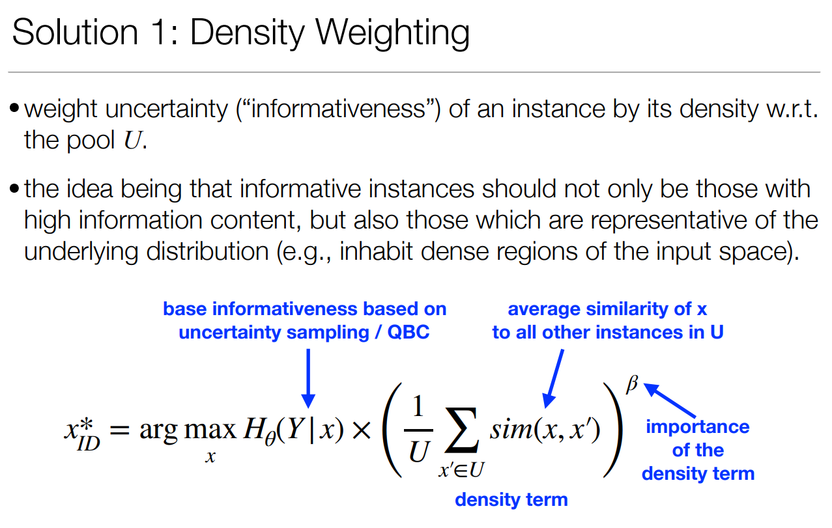
How to have the best choose among uncertainty samples?
<number>
https://edithlaw.ca/teaching/cs480/w19/lectures/12-active-learning.pdf

Slide 11
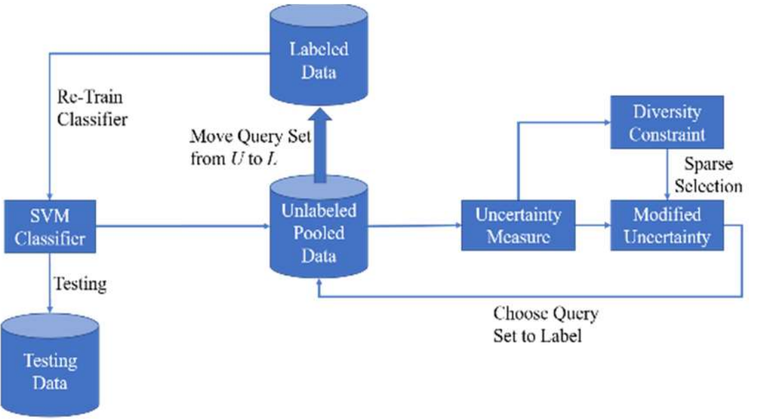
Paper: Uncertainty Sampling Based Active Learning with Diversity Constraint by Sparse Selection
Problem: Choose uncertainty samples to be queried. This paper considered:
Uncertainty Measure Design
  Choose the most uncertain samples from the unlabeled data pool to label. They used SVM to measure uncertainty score, see formula
Active Learning via Sparse Selection Modeling
  Given uncertainty scores generated from the classifiers, we would like to select the most informative samples for a query. The simplest selection strategy is that we always select the samples up to the batch size ܤ ௤with the largest uncertainty scores.
  However, this strategy ignores the relations among the pooled unlabeled samples. Sometimes the samples with top uncertainties are very similar to each other. Selecting all of such samples may obtain the same information as selecting just one sample. In other words, similar samples should not be selected at the same batch and diverse samples are needed for a query.
  we want to make sure that only one sample among similar samples have large uncertainty and the uncertainties from other samples become smaller.
How to find out closest samples to svm hyperplane?
This link helps
<number>
https://ieeexplore.ieee.org/stamp/stamp.jsp?tp=&arnumber=8122269&tag=1

Slide 12
Emprical Analysis of Acrive Learning
An important question is: “does active learning work?” Most of the empirical results in the published literature suggest that it does (e.g., the majority of papers in the bibliography of this survey).
Furthermore, consider that software companies and large-scale research projects such as CiteSeer, Google, IBM, Microsoft, and Siemens are increasingly using active learning technologies in a variety of real world applications2
<number>

Slide 13
Real Challenges in practice
As a result, the research question for active learning has shifted in recent years to “can machines learn more economically if they ask questions?”
<number>

Slide 14
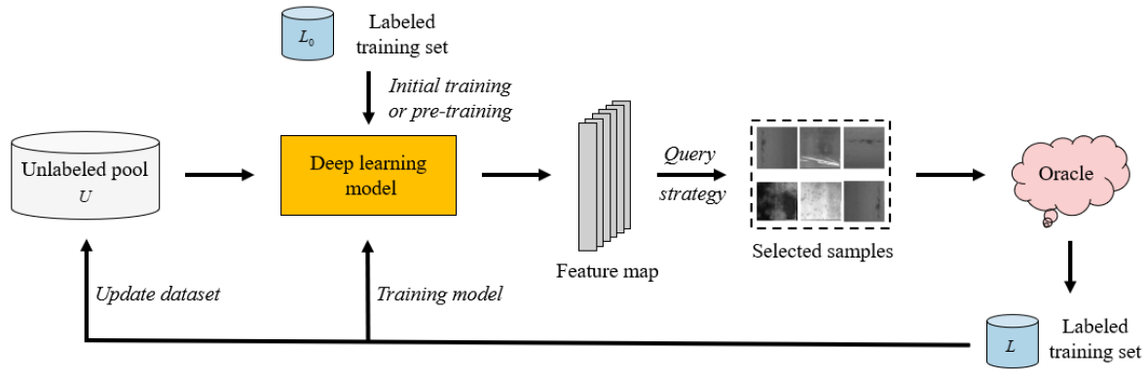
Deep Active Learning
A typical example of deep active learning
<number>
Paper:A Survey of Deep Active Learning

Slide 15
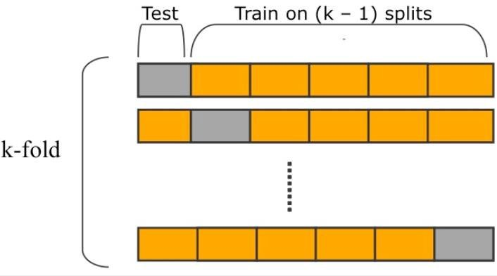
Our Scenario
<number>

Slide 16


Active Learning with SVM
Passive Learning (Random Sampling)
Unlabeled Data
Batch=500
Labeled by expert
labeled Data
Re-training
SVM
Test
Evaluate
Active Learning (Uncertainty Sampling)
Labeled by expert
labeled Data
Re-training
SVM
KNN
Random Forest
Yes
Unlabeled Data
High confidence
C > T?
Batch=500
SVM
No
Less confidence
Test
Evaluate
<number>

Slide 17
Active Learning via Ensemble Learning
Active Learning (Uncertainty Sampling)
Query-By-Committee
  The QBC approach involves maintaining a committee C = {clf1,clf2,…clf(n)} of models which are all trained on the current labeled set L, but represent competing hypotheses. Each committee member is then allowed to vote on the labelings of query candidates. The most informative query is considered to be the instance about which they most disagree.
Labeled by expert
labeled Data
Re-training
CLF1
Yes
Unlabeled Data
Ensemble
High confidence
C > T?
Batch=500
CLF2
No
Less confidence
CLF1
Using average of predict_proba(X)[source]¶
Test
Evaluate
<number>

Slide 18
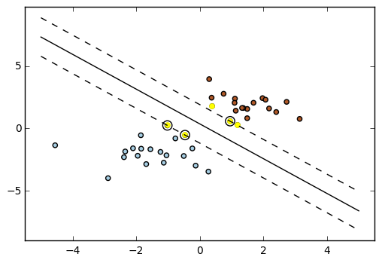
Active Learning with SVM
Active Learning (Sampling of top datapoints closest to the hyperplane) : Use decision Function. Closest to Hyperplane(ref)
(Hyperplane hashing ref)
Labeled by expert
labeled Data
Re-training
Unlabeled Data
Batch=500
SVM
Take closet samples
Test
Evaluate
<number>

Slide 19
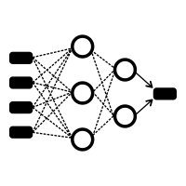
Deep Active Learning with CNN: Retraining
Passive Learning (Random Sampling)
Unlabeled Data
Batch=500
Labeled by expert
labeled Data
Re-training
Test
Evaluate
Active Learning (Uncertainty Sampling)
Labeled by expert
labeled Data
Two predict options in TF
Model.predict: gives probbility
Model.predict_classes
Re-training
Yes
Unlabeled Data
High confidence
C > T?
Batch=500
No
Less confidence
Test
Evaluate
<number>

Slide 20
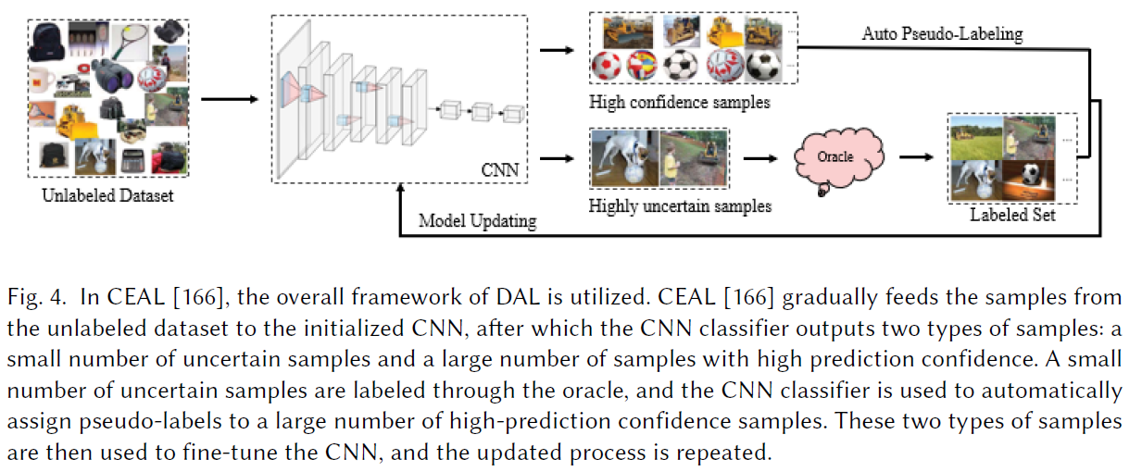
Deep Active Learning with CNN: Batch Training
Passive Learning (Random Sampling)
Unlabeled Data
Batch=500
Labeled by expert
labeled Data
Batch Training
Use model.train_on_batch (data, label), ref
Test
Evaluate
Active Learning (Uncertainty Sampling)
Labeled by expert
labeled Data
Use model.train_on_batch (data, label), ref
Batch Training
Yes
Unlabeled Data
High confidence
C > T?
Batch=500
No
Less confidence
Test
Evaluate
<number>
Paper: A Survey of Deep Active Learning

Slide 21
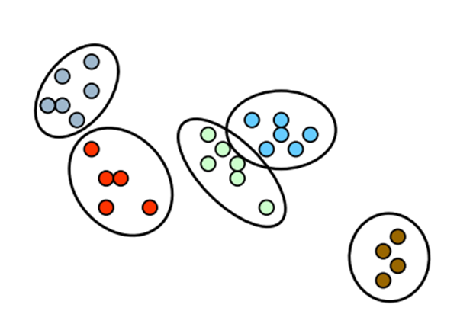
Deep Active Learning with CNN: Clustering
Active Learning (Uncertainty Sampling)
label propagation
Labeled by expert
Labeled Data
Batch Training
choose the centroid points
C > T?
Unlabeled Data
High confidence
Yes
Batch=500
Clustering
No
Less confidence
Test
Evaluate
Question: How to optimitze the number of questions to Oracle? Clustering + label propagation
<number>

Slide 22

Deep Active Learning with CNN: Clustering
Active Learning (Uncertainty Sampling)
Labeled by expert
Labeled Data
Clustering
Batch Training
Unlabeled Data
C > T?
Batch=5000
High confidence
Yes
No
Less confidence
Test
Evaluate
Compare number of query to the Oracle
<number>

Slide 23
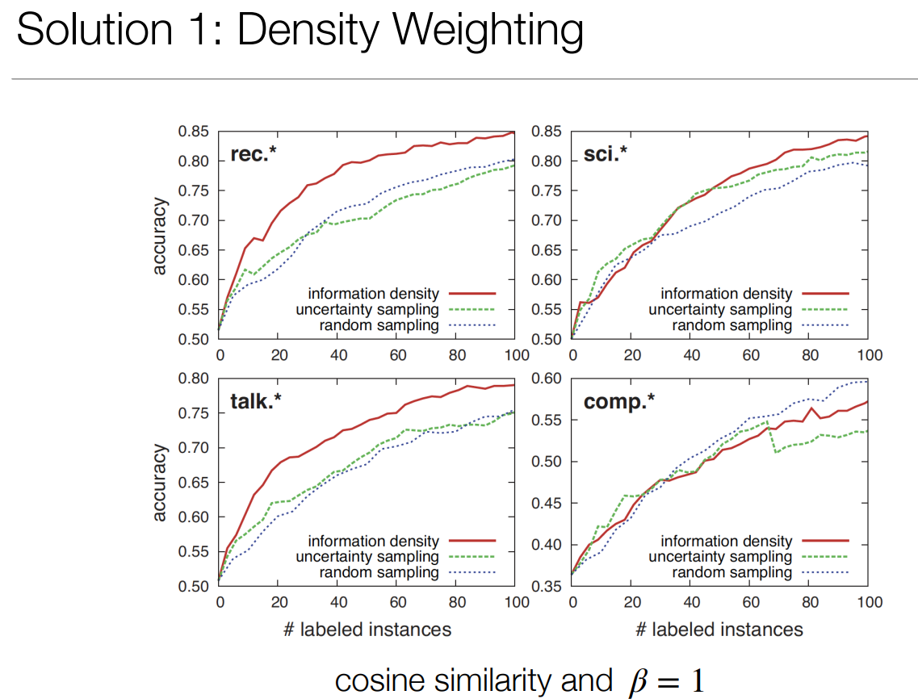
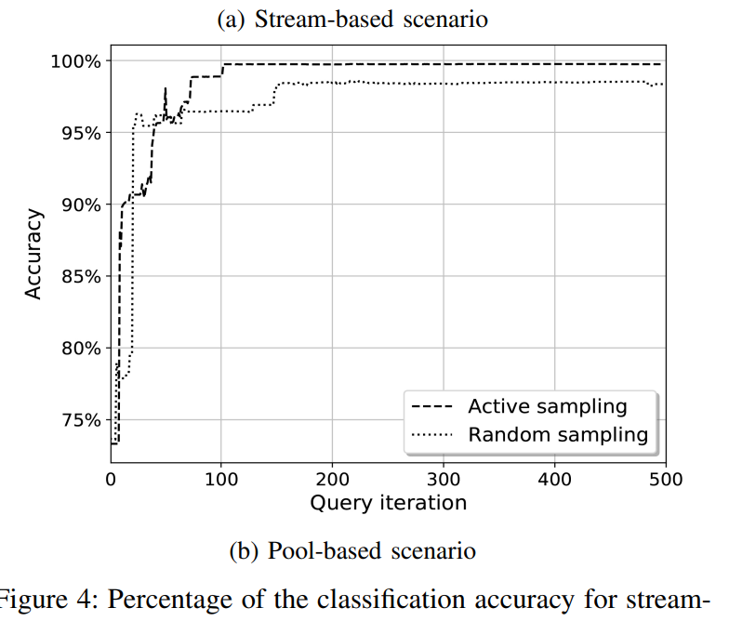
Results
Error
Accuracy
Number of Labels
Number of Re-train
Accuracy
Accuracy
Expert Time
Number of Query
https://edithlaw.ca/teaching/cs480/w19/lectures/12-active-learning.pdf
https://arxiv.org/pdf/2106.06933.pdf
<number>

Slide 24
Criteria & Assumptions
# of query (asking oracle)
# of samples
Number of iteration
Re-training vs batch training in CNN
Time of oracle: consideting the assumption of 1 sec for labeling one sample : w.r.t slide 21
<number>

